Slide 1

TCO of requested Case Study
Credit Card (CC) Transaction for a Bank
Author: Kalashnikova Polina

Slide 2
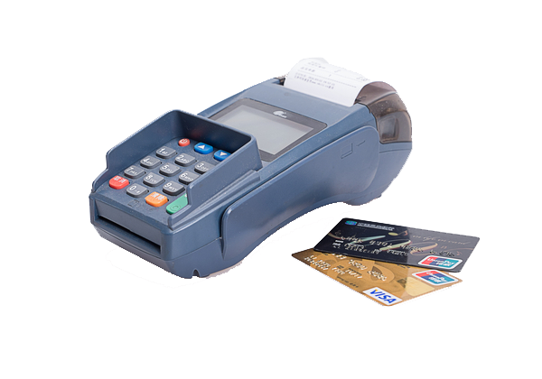
Description of the environment UC & required TPS
UC: Credit Card (CC) Transaction for a Bank
Every CC transaction requires:
Checking the CC is valid,
Checking the POS is valid,
Checking the money amount is valid
That the specific CC is within single transaction limits, daily limits and monthly limits
If the CC is pre loaded CC, that there is sufficient money in the basket
Check if the transaction is suspect
Run AI to warn or stop suspect transactions
If the POS requires a second identification step, perform that step and check complete
successfully,
At the end of the transaction, issue OK or abort
Store all the information about the transaction whatever is the exit status

Slide 3
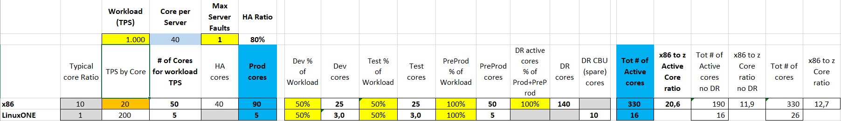
Sizing
The input provided is that the systems must support up to 1000 TPS
Our input is that a x86 core is able to process 20 TPS*
Based on literature and what said previously, a LinuxONE core (aka IFL) is able to perform 10x TPS, therefore 200 TPS
*A precise sizing would require to know the x86 server and its config. Yet, as the differences of these servers would not impact the overall view, for simplification we adopt this approach

Slide 4
Technical Architectures for the two cases: inputs 1000 TPS
Site 1
Site 2
Case 1:
x86 Server:
Rack server w Xeon Gold 6242 20C 3.10GHz (2 Chips, 40 Cores)
12 servers
330 cores
Prod:
3 servers
90 cores
PreProd:
2 servers
50 cores
Dev:
1 servers
25 cores
Test:
1 servers
25 cores
DR:
5 servers
140 cores
Case 2:
LinuxONE Server
2 servers
16 cores (IFL)
and 10 spares (CBU)
1 LinuxONE with:
1 LinuxONE with:
Prod:
5 cores
Dev:
5 cores
Spare:
5 CBU
Pre-Prod:
5 cores
Test:
5 cores
Spare:
5 CBU

Slide 5
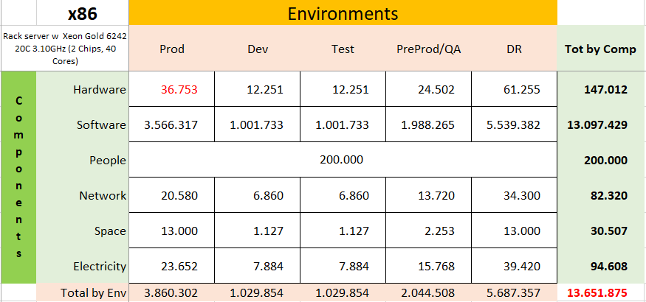
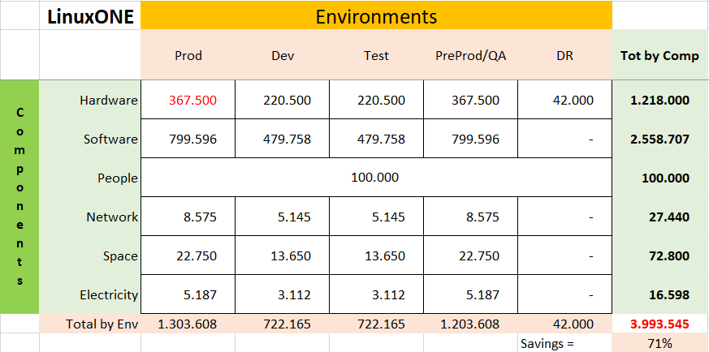
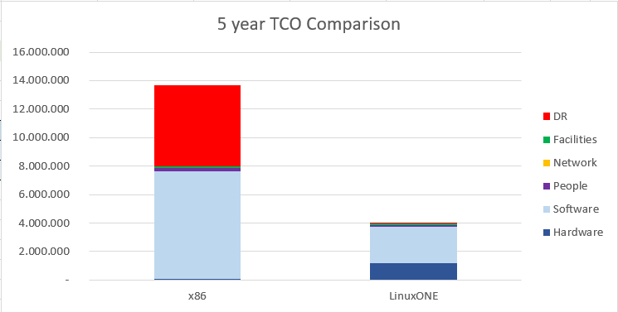
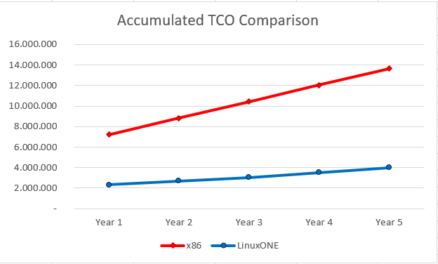
TCO Comparison on 5 years
Above schemas summarize the TCO for the different environments on 5 years, for each cost component
-The savings with the LinuxONE platform is 51% vs the x86 equivalent platform
Below diagrams highlights the component contribution to total cost and cost per year that make the accumulated TCO

Slide 6
x86 TCO Assumptions
Hardware
Rack server w Xeon Gold 6242 20C 3.10GHz (2 Chips, 40 Cores)
Acquisition cost: 12,5K€ -30% discountincluding 3 years Support
Support for following years is 20% of purchase price
Network
7000€ per Server -30% discMaint@ 10% of PP from y2
People
One FTE covers 30 servers
Average yearly fully loaded costs=100K€
Space
Fully loaded cost of Sq. meter=2.800€
Electricity
Cost per kWh=0,30€
Software
OS: subscription 2000€/year –20% disc per socket
VM: license 5000€/socket -20% discmaint@ 20% of purchase price from y2
Application Server: license 1062€/PVU -75% disc (70 PVU per core)maint@ 20% of purchase price from y2
DB: license 14.000€ for 2 cores -75% discmaint@ 20% of purchase price from y2
Data Replication Tools: subscription 3000€/year –75% disc per core
Monitoring Tools: license @5.000€/server -40% disc. Maint@ 20% of PP from y2
Security Tools: license @5.000€/server -40% disc. Maint@ 20% of from y2

Slide 7
LinuxONE TCO Assumptions
Hardware
LinuxONE servers configured as the example @ 725K€ for 3 years –30% disc
Maint@ 10% PP from y4
Support for following years is 20% of purchase price
Network
14000€ per LinuxONE Server -30% disc
Maint @ 10% of PP from y2
People
One FTE covers 30 servers
Average yearly fully loaded costs=120K€
Space
Fully loaded cost of Sq. meter=2.600€
Electricity
Cost per kWh=0,10€
Software
OS: subscription 6000€/year –20% disc per socket
VM: included in HW
Application Server: license @100€/PVU -50% disc (120 PVU per core) maint @ 20% of purchase price from y2
DB: license @40.000€ per cores -50% disc maint @ 20% of purchase price from y2
Data Replication Tools: subscription 3000€/year –50% disc per core
Monitoring Tools: license @5.000€/server -40% disc. Maint@ 20% of PP from y2
Security Tools: license @5.000€/server -40% disc. Maint@ 20% of from y2

Slide 8
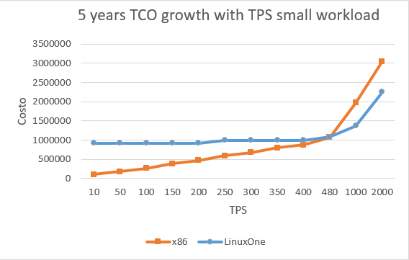
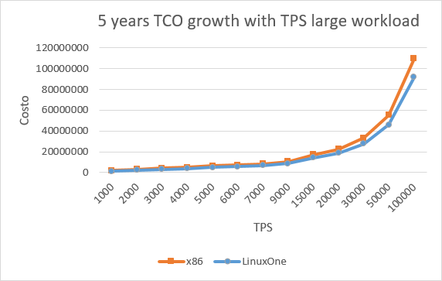
How TCO changes with TPS

Slide 9

Links
Link to GitHub
Server configurator
Microsoft SQL Server pricing
Application server pricing
Author: Kalashnikova Polina
Notes:
Wählen Sie im Präsentationsmodus die Pfeile aus, um Links zu folgen.

